Slide 1
Deep Learning: Methods and Applications
Leeladhar MuNNANGI
mleeladharreddy@gmail.com

Slide 2
Deep Learning
Are Present day Computers really Intelligent ?
Do we really need Deep Learning ?
How can we build more Intelligent Computer Systems ?

Slide 3
Deep Learning
General Approach
Programming a computer for every task
Cannot write algorithms to each task we want to accomplish separately
Artificial Intelligence
Generate Understanding from raw data
Need to write general algorithms that learn from observations

Slide 4
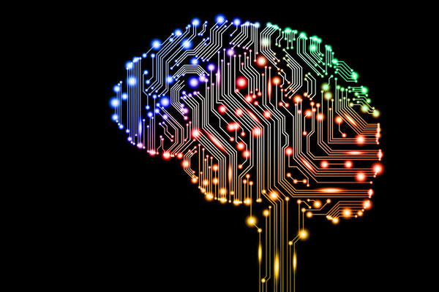
Deep Learning
Deep Learning: A class of machine learning techniques that exploit many layers of non-linear information processing for supervised or unsupervised feature extraction and transformation, and for pattern analysis and classification.

Slide 5
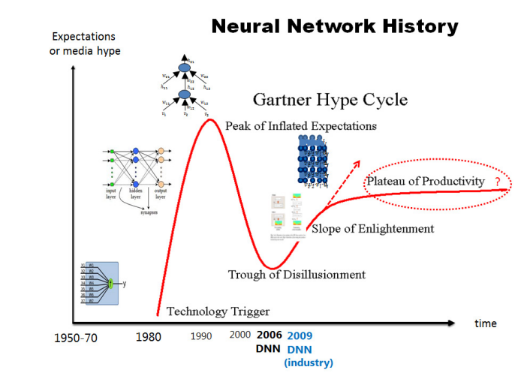
History of Deep Learning

Slide 6

Deep Learning
Two generations of deep learning software systems:
1st generation: DistBelief
2nd generation: TensorFlow

Slide 7
Plenty of Data
Text: trillions of words of English + other languages
Visual: billions of images and videos
Audio: thousands of hours of speech per day
User activity: queries, result page clicks, map requests, etc.
Knowledge graph: billions of labelled relation triples

Slide 8
Many Problems = One Solution
Nice property: same general approach works for many problems/domains.
More Data + Bigger Model = Better Results
Many problems have virtually limitless data, so only issue is how big a model we can train

Slide 9
Classes of Deep Learning
Deep networks for unsupervised or generative learning.
Deep networks for supervised learning
Hybrid deep networks

Slide 10
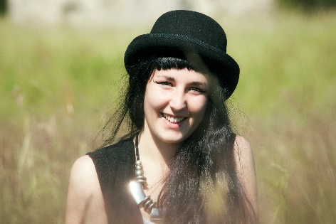
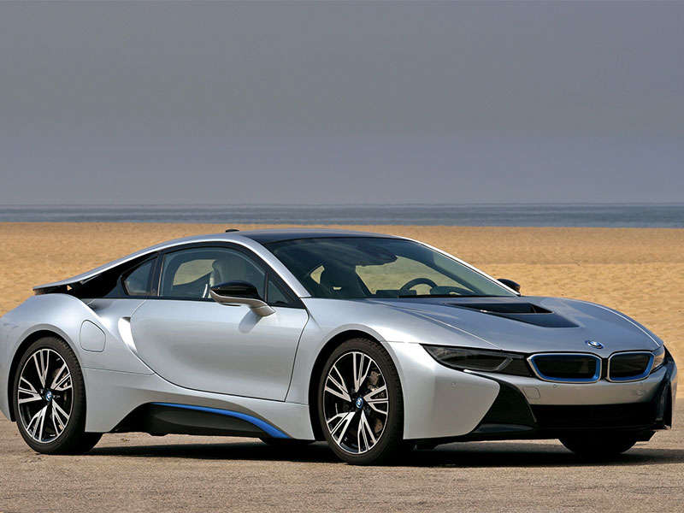
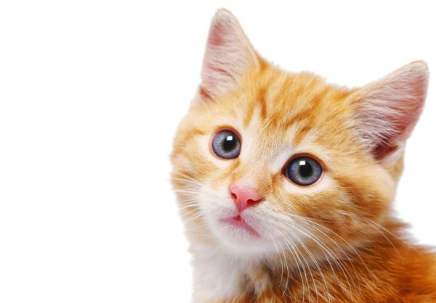
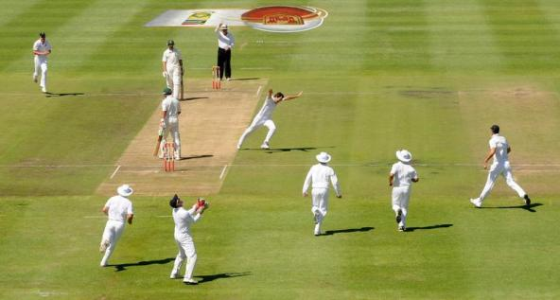
Untagged data (Unsupervised data)
Unknown
Unknown
Unknown
Unknown

Slide 11
Deep networks for unsupervised or generative learning
Deep belief network (DBN)
Boltzmann machine (BM)
Restricted Boltzmann machine (RBM)
Deep neural network (DNN)
Deep autoencoder

Slide 12



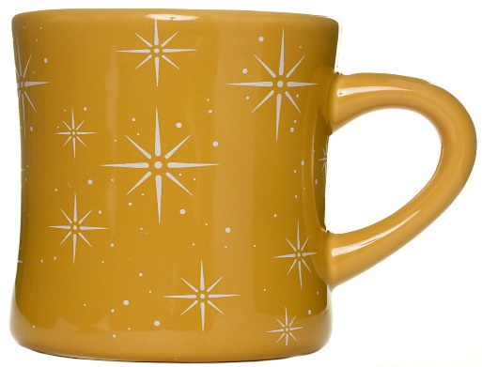
Tagged Data (Supervisied Data)
Coffee Mug
Coffee Mug
Coffee Mug
Coffee Mug

Slide 13
Hybrid deep networks
Hybrid deep Networks: The term “hybrid” for this third category refers to the deep architecture that either comprises or makes use of both generative and discriminative model components.

Slide 14



Applications of Deep Learning
Speech
Image
Text

Slide 15
Image Recognition
Image recognition involves two core tasks:
Image classification:
In image classification, the computer is taught to recognize object categories, such as “person,” “cat,” “dog,” or “bike,”.
Object detection:
Computer needs to provide the precise positions of the objects in the image

Slide 16
Spatial Pyramid Pooling (SPP)
Powerful new network structure
Information aggregation is achieved deeper in the network.
Computed once on the image but still can produce descriptors(objects) for thousands of regions.

Slide 17
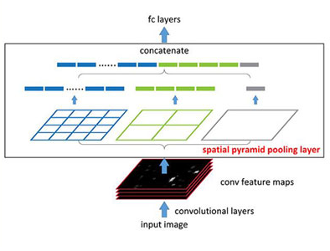
Spatial Pyramid Pooling (SPP)

Slide 18
Current Work
Actively building TensorFlow, our next-generation of training and inference software.
Deep Learning is implemented by Google, Microsoft, Facebook so on.
Google Brain

Slide 19
References
https://www.technologyreview.com/s/513696/deep-learning/
http://research.microsoft.com/pubs/209355/DeepLearning-NowPublishing-Vol7-SIG-039.pdf

Slide 20
Queries Please !!

Slide 21


